Slide 1

AirTaxi (Airline Reservation System)
Have A Safe Flight!!!
Group no: 99
Presented By-
Ashish Sawant(223177)
Abdulaziz shaikh(223180)

Slide 2
Agenda:
Problem Statement
Introduction
Scope
Technology used
Roles
Functionality
Use Case diagram, Activity Diagram
Website Format

Slide 3
Problem Statement
To develop a computerized reservation system meeting the rising customer interest in booking online air travel reservations. The system should be convenient, user friendly and available via the Internet.
The system shall allow the users to view entire flight information of the airline, book tickets, view or, if required, cancel current reservations, and create member login for standalone users and create discounts as per frequent flier mileage program.

Slide 4

Introduction
The main objective of the AirTaxi is to manage the details of Passenger Reservation, Airline Enquiry, Airlines Booking, Ticket Booking.
It manages all the information about Passenger Reservation, Booking Enquiry, Passenger, Passenger Reservation.
The project is totally built at administrative end and thus only the administrator is guaranteed the access.
The purpose of the project is to build an application program to reduce the manual work for managing the Passenger Reservation, Airline Enquiry, Booking Enquiry, Airlines Booking.
It tracks all the details about the Airlines Booking, Ticket Booking, Passenger.

Slide 5
The airline booking website is an application stored in the user server. The purpose of the website is to resolve the client to allow website users to perform tasks related to booking an airline flight. The system enables to perform the following functions:
Scope
Automation of flight operations
Automation of ticketing/seat booking
confirmation system
Cancellation
Improved and optimized service

Slide 6
Technology Used :
We used Java Spring-Boot as backend and React JS as Frontend in our Project.
Spring-Boot :–
The main goal of the Spring Boot framework is to reduce overall development time and increase efficiency. React has become the first choice for frontend because it gives developers the ability to work with a virtual browser (more friendly than the real browser). Also, a JavaScript developer can become a productive developer in a few hours because there is a small API to learn, a few functions, and how to use them…
React :–
React allows developers to create large web applications that can change data, without reloading the page. The main purpose of React is to be fast, scalable, and simple.
MySQL Database :–
MySQL creates a database for storing and manipulating data, defining the relationship of each table.

Slide 7

Roles:
Users
Admin
In this module Users can register itself, search flights, book flight, cancel the flight, view the booking details.
In this module Admin can add Airline details, cancel the flights, And update the flight details..

Slide 8

Product Function
User requirements
User properties like first name , last name, email, password, contact number.
Associated with Flight Miles accumulated and Credit Card information.
Admin add Flight properties like Departing/Arriving City, Departure/Arrival dates and times and an identifying Flight Number.
Flight Seat properties of identifying seat number, reserved and flight Associated to Flight by flight number.

Slide 9
Product Function
SEARCH: This function allows the Passenger to search for airplanes and ticket's availability between two cities, i.e. departure city and arrival city, the date of departure, preferred time and number of passengers.
SELECTION: This function allows a particular airplane to be selected from the displayed list.
All details such as:
airplane number
Date, time and place of departure
Date, time and place of arrival
Fare per head etc.

Slide 10
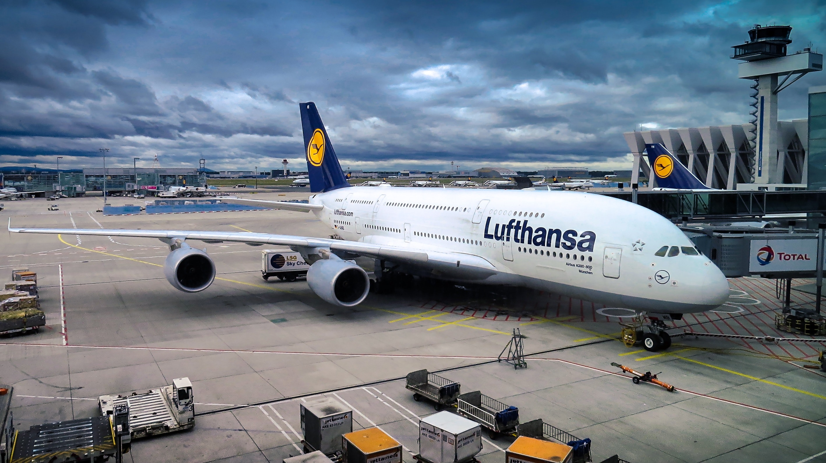
Product Function
Payment: It asks to enter the various credit card details of the person making reservation i.e.
Credit card type
Credit card number
Expiration date of the card.
The name on card etc.
Cancellation: The system allows the passenger to cancel a reservation and register the information regarding his/her ticket. It includes Confirmation no, name, date of journey, fare deducted.

Slide 11

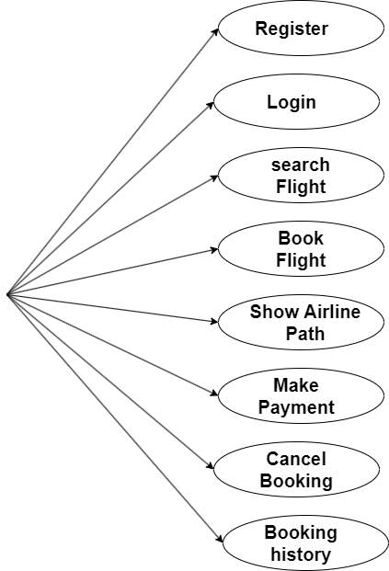
User Use Case Diagram
Users

Slide 12
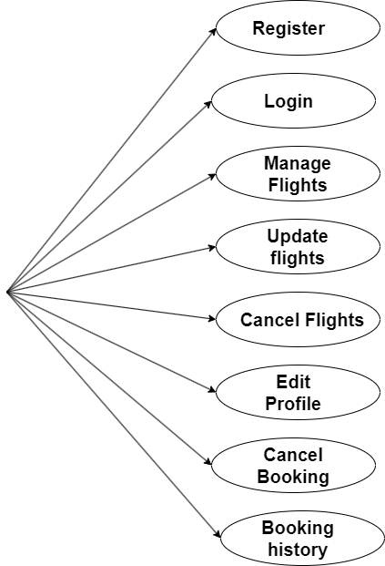
Admin Use Case Diagram
Admin

Slide 13
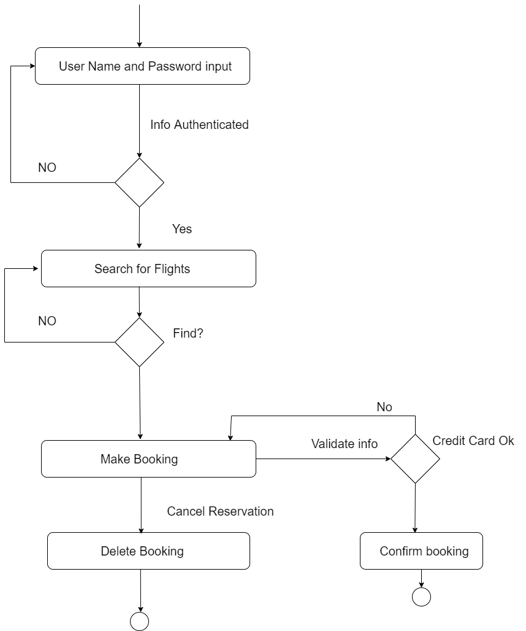
User Activity Diagram
User

Slide 14
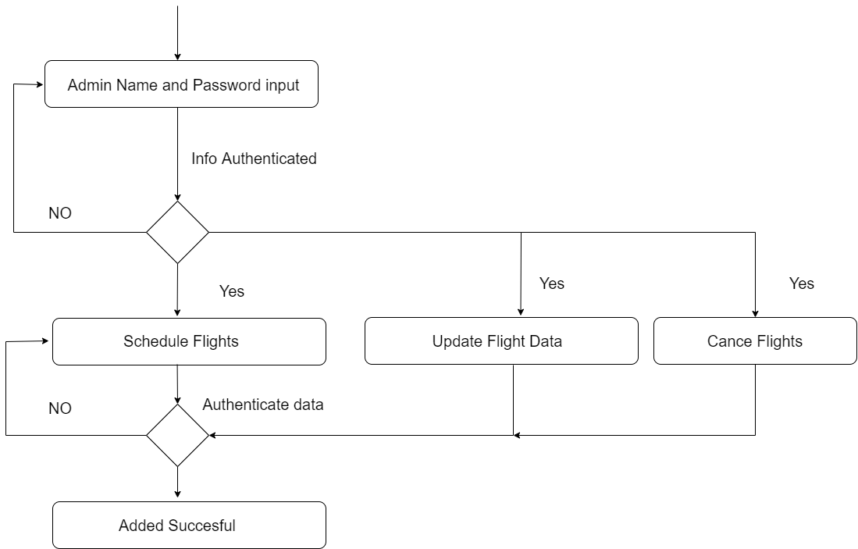
Admin Activity Diagram
Admin

Slide 15
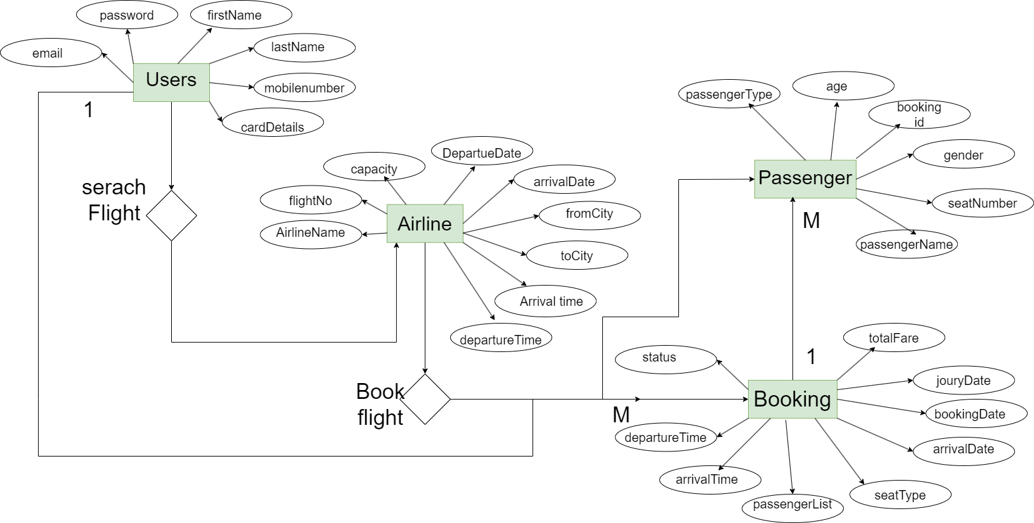
ER Diagram

Slide 16
Website Interfaces -

Slide 17
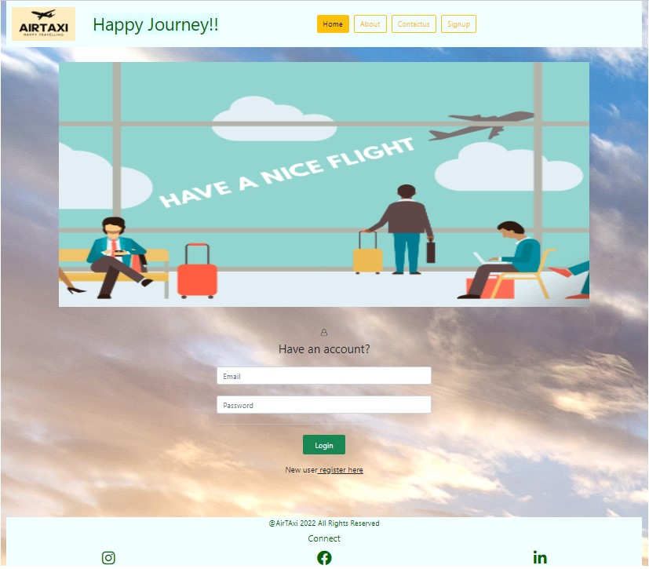
Home Interface

Slide 18
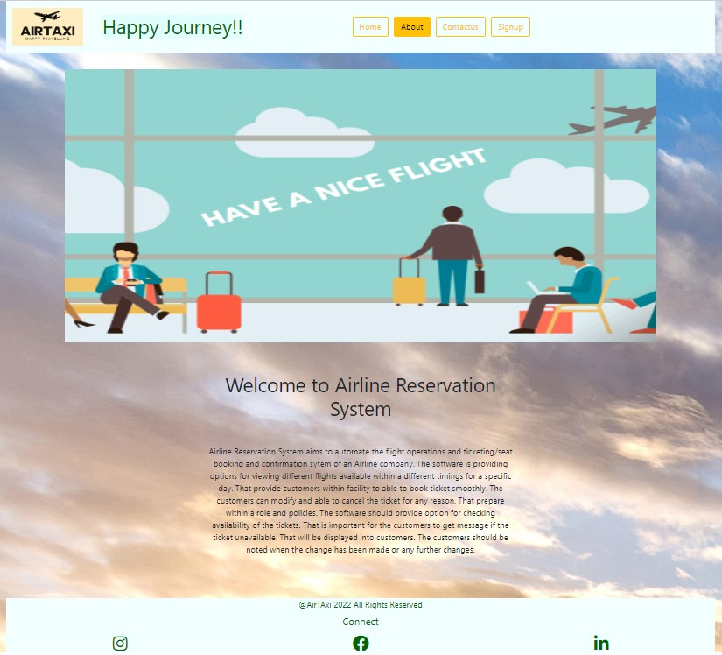
Aboutus

Slide 19
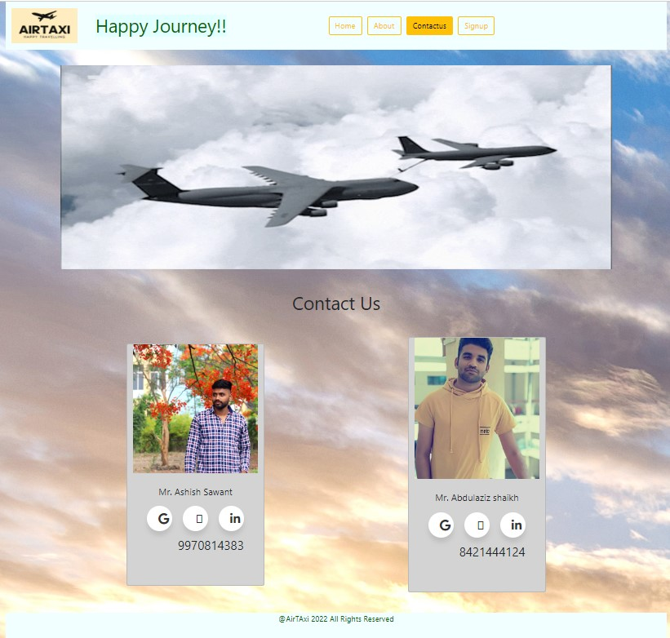
Contactus

Slide 20
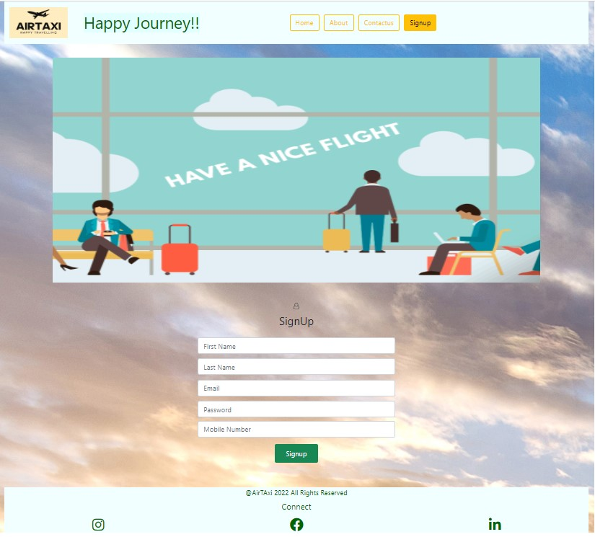
Signup

Slide 21
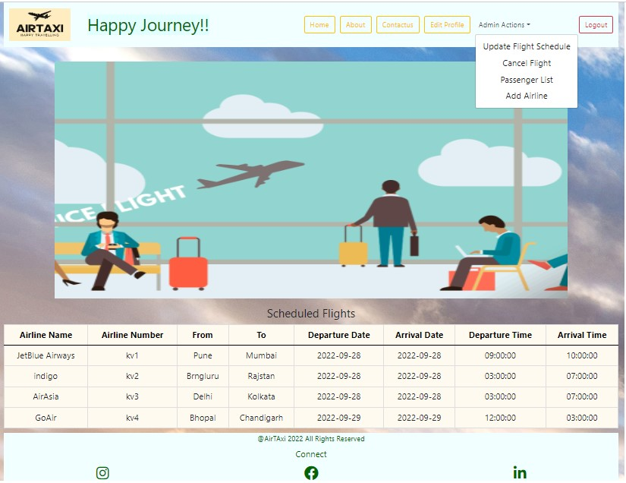
Admin Page

Slide 22
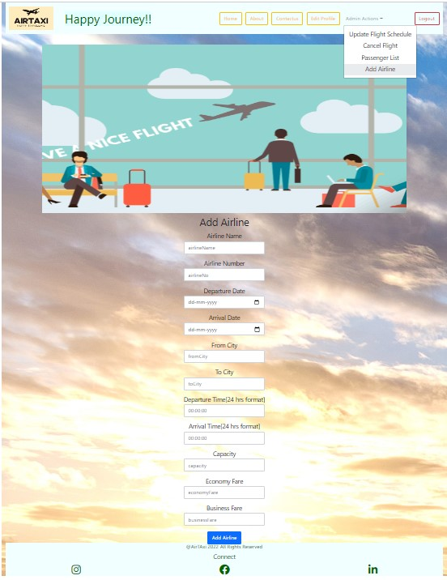
Add Flights

Slide 23
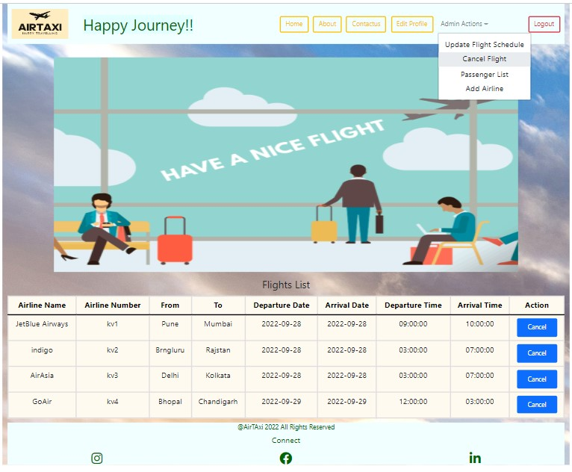
Cancel flights

Slide 24
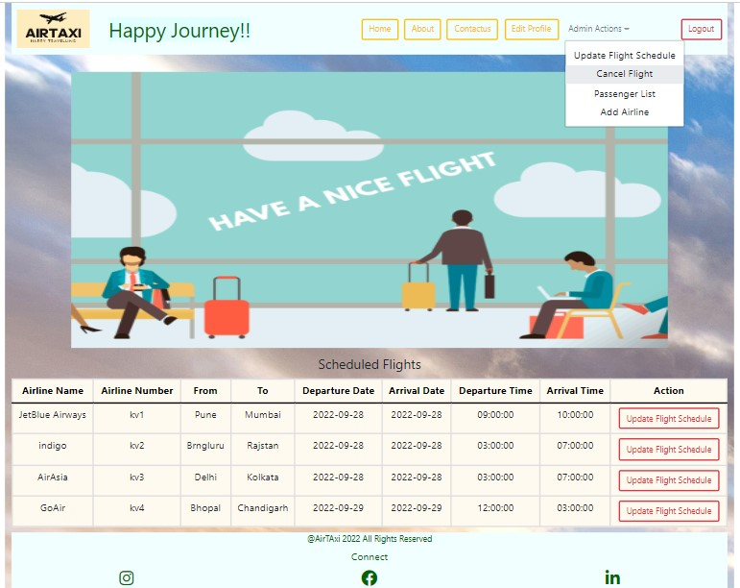
Update Flights

Slide 25
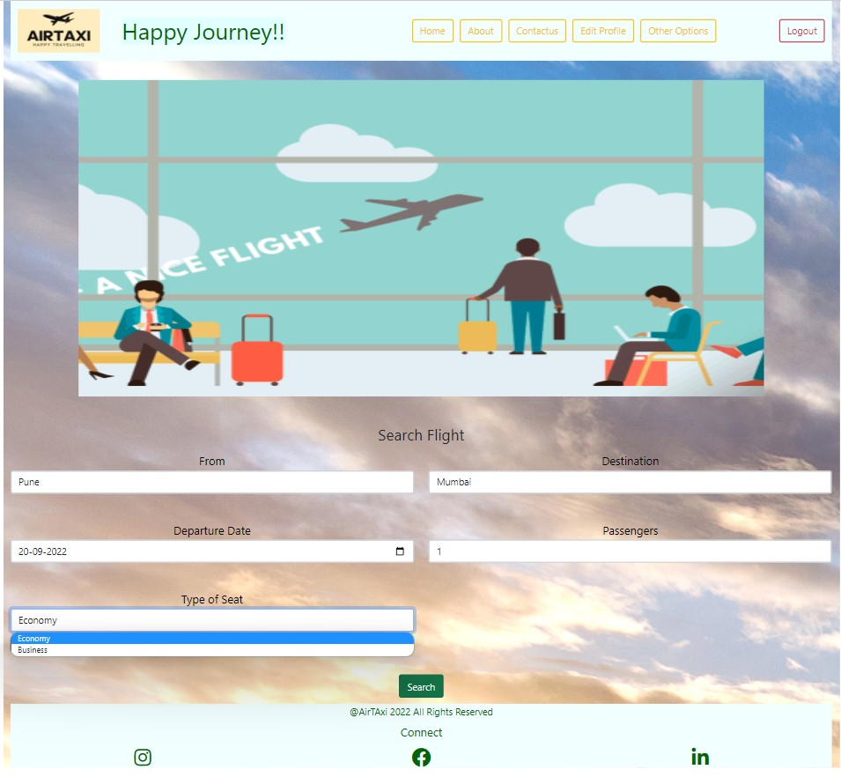
Customer Interface

Slide 26
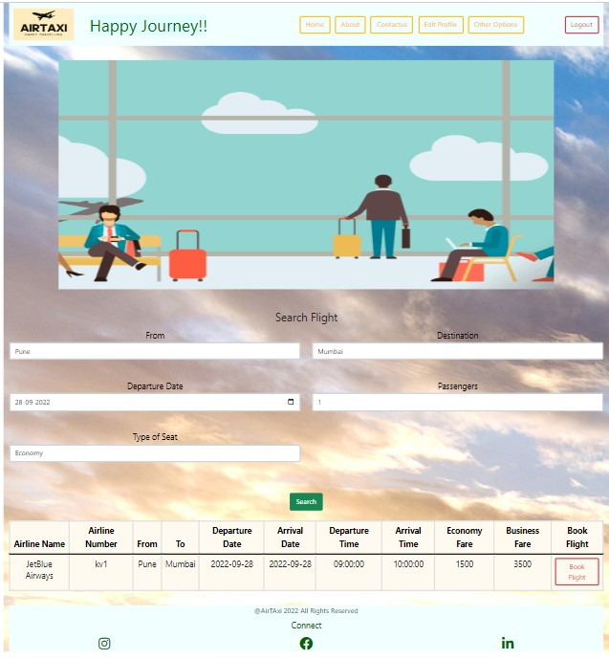
Book Flight

Slide 27
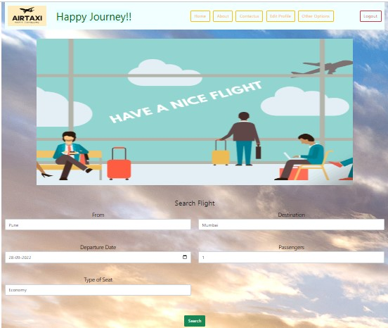
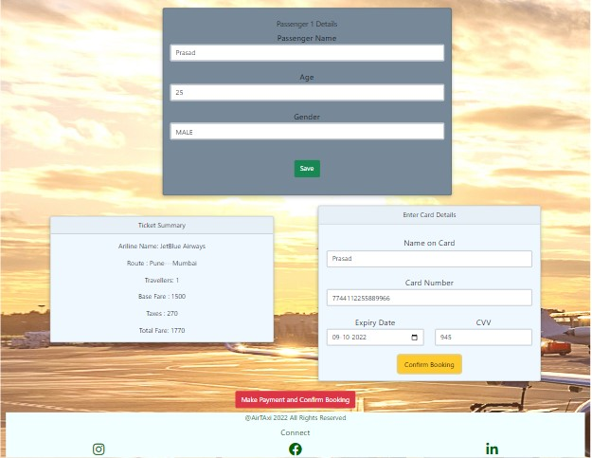
Booking Details & Card Details

Slide 28
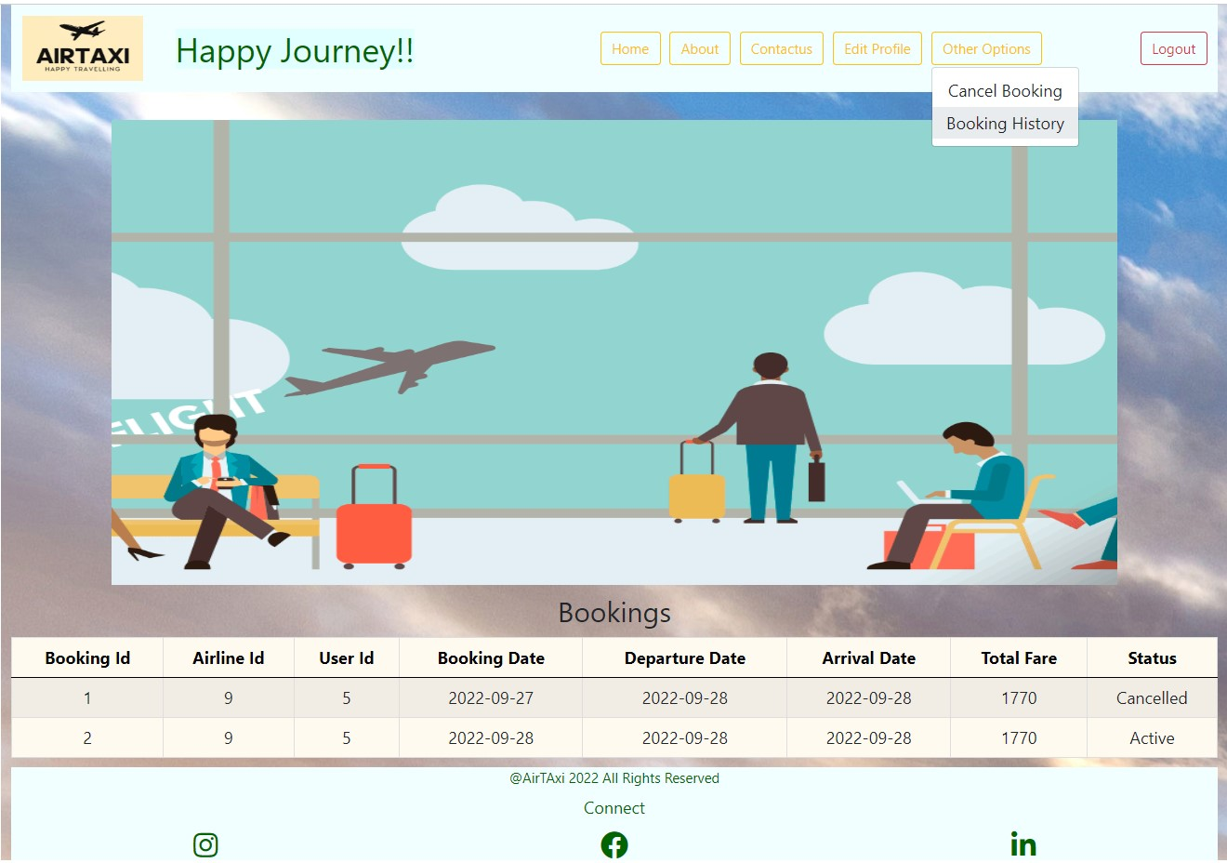

Slide 29
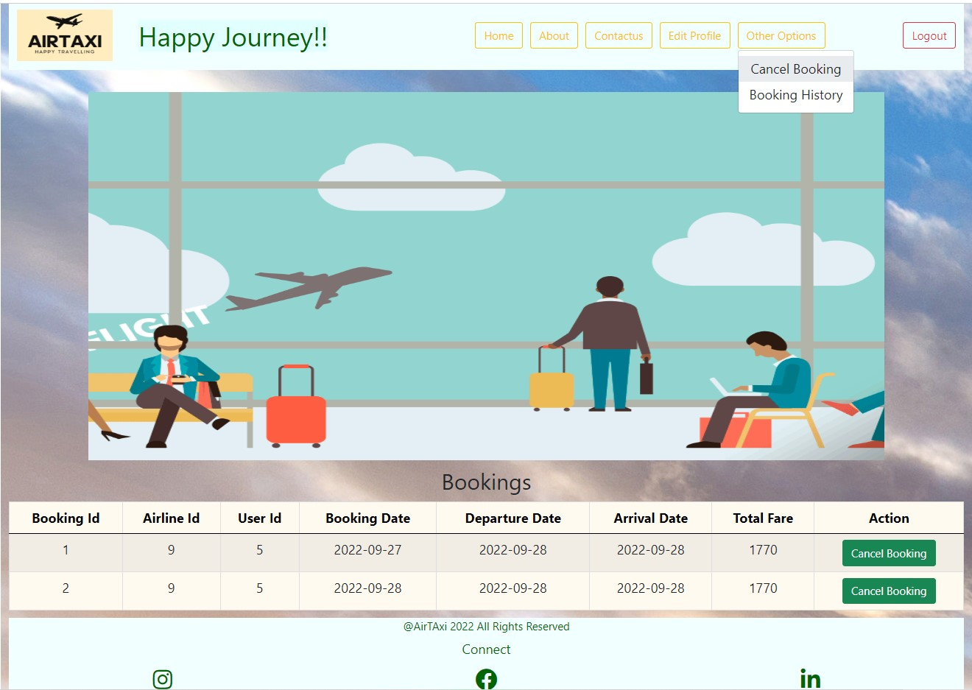

Slide 30
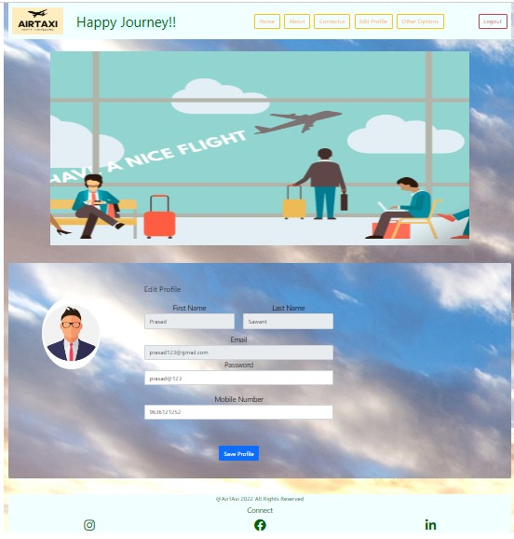
Edit Profile

Slide 31


Our team
Ashish
Abdulaziz
ashish99.sawant@gmail.com
Roll number :223177
abdulazizshaikh400@gmail.com
Roll Number : 223180

Slide 32

Thank you !!

Slide 33

Last year

